Slide 1
1. Status of RHICf proposal and plans
2. T dependence correction (by Matsubayashi)
Takashi SAKO
STEL/KMI, Nagoya University

Slide 2
RHICf

Slide 3
3 Physics Motivations
Feynman scaling
  RHIC 500GeV pp gives a similar x_{F}-p_{T} coverage to LHC 7TeV run than LHC 900GeV
Nuclear effect in the light ion collision
  Realization of world-first light ion collision
Spin asymmetry in the forward neutron
  Innovated at RHIC
  LHCf type detector with a better position resolution than ZDC gives better measurements

Slide 4
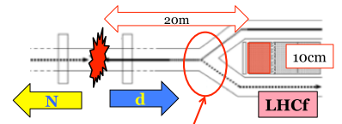
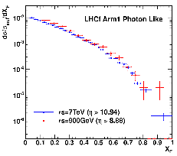
LHC single gamma data
(900GeV pp / 7TeV pp)
Preliminary
RHICf 500GeV
LHCf 7TeV
pT (GeV/c)
LHCf 900GeV
2
1
0
100
200
E (GeV)

Slide 5
Nuclear modification factor
Eπ⁰ and En (200 GeV p-p / p-N)
DPMJET3
QGSJET-II
EPOS
DPMJET3
QGSJET-II
EPOS
p-p
p-N
p-p
π⁰
p-N
n
100
E(GeV)
100
E(GeV)
(p-N/p-p)
(p-N/p-p)
1
1
π⁰
n
0
0
100
E(GeV)
100
E(GeV)

Slide 6
Spin asymmetry A_{N} for very forward neutron production
Y. Fukao et al., Phys. Lett. B650, 325-330 (2007). [hep-ex/0610030].
Polarized php at 62, 200 500 GeV
Δp_{T}
B. Z. Kopeliovich, et al. ,
PRD84, 114012 (2011).
No A_{N} at backward
A_{N} only at very forward
Need finer pT resolution !

Slide 7
Activity since April
May: submission of LOI to RHIC PAC
June: Presentation at PAC by Itow
  Recommendation to submitting a proposal
  Home works; LHCf detector really optimum? why low energy experiment? (more quantitative evaluation of Feyman scaling study)
September: Draft beam schedule of RHIC for next few years (see next slide)
  No 500GeV p-p in the next few years
October: Preparation of a short letter to PAC by Sako, Itow and Goto (later slides)
November: Request from PHENIX to explain the idea of RHICf
December: Presentation of Goto at PHENIX meeting and Executive Committee (later slides)
  Possible scenarios for 2015-2016 run in two cases; 200GeV and 500GeV are necessary
  Further discussions in Feb

Slide 8
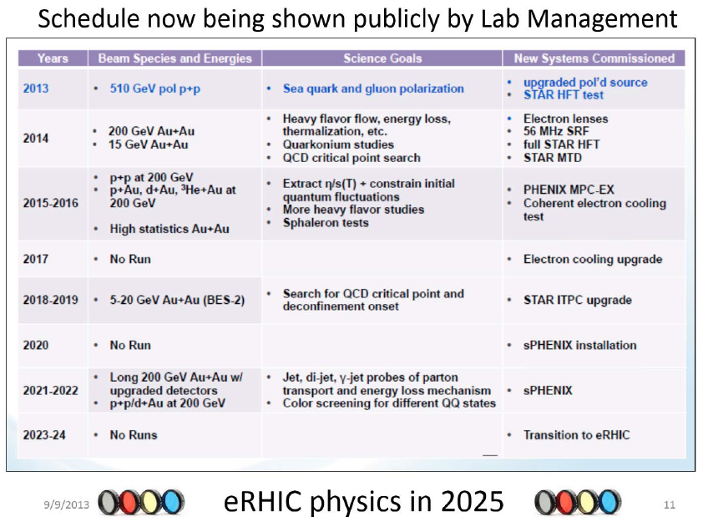
DONE
THIS WINTER
RHICf target, but no 500GeV p-p

Slide 9
Letters to PAC and PHENIX
We suppose to operate at the PHENIX IP
SCHEDULE
2015 LHC 13 TeV
2016 RHICf using LHCf detector
  Pilot run
  We need some helps for combined DAQ with PHENIX
2017 Preparation for the dedicated detector
2018, 2019 RHICf using dedicated detector
  Main physics run
PRIORITY
500GeV pp for Feynman scaling study
Asymmetry study together with pp
200GeV pN, NN

Slide 10
Answer from PHENIX
Goto san presented only physics motivations and beam requests on 10-Dec
PHENIX needs a few pages of possible scenarios for two cases of 2015-2016 operation in the EC meeting on 13-Feb
  CASE1: 500GeV p-p; needs interests inside the group
  CASE2: 200GeV p-p (p-A); relatively easier
According to the scenarios, they will discuss how they include it in their operation proposal submitted to 2014 PAC
Collaboration style can be discussed freely (no discussion on 10-Dec)

Slide 11
Our answers to give in Feb (TBD)
500GeV p-p is the first priority
Limiting the discussion on the 2016 run, we will join even only with 200GeV p-p (p-A) because
  This is a pilot run for 2018-2019
  LHCf detector does not have ideal coverage
Collaboration style
  Independent is ideal, but…
  Inside PHENIX is OK (Japanese OK, but Italian?)
  Paper with 400 authors… we do not like
  Shift for the main PHENIX physics… not easy
  Other items?

Slide 12
Why new detector?
Less limitation by beam-pipe shadow than LHC
We lose chance to detect low energy pi0
We miss 0 degree during high eta scan
LHCf detector is optimized to TeV (sampling frequency)
Beam pipe shadow
RHIC aperture
r = 10cm
Why new DAQ?
Reducing cabling cost and time
Unifying to the PHENIX DAQ => reducing the efforts to prepare full DAQ and operation
PMT signal => PHENIX ADC, maybe simple
Silicon or SciFi => need some works
DAQ in the tunnel depend on the radiation
0 degree

Slide 13
Option to the position sensors
Using current sensors
  Detector is well known
  Need R&D to cooperate with the PHENIX DAQ
Using a PHENIX silicon sensors
  Detector to be studied
  Maybe easy for DAQ
  A possible candidate; Silicon-pad used in the PHENIX Muon Piston Calorimeter Extension (MPC-EX)
    62mmx62mm
    array of 1.8mmx15mm pads
    1.8mm interval OK?
    arXiv:1301.1096v1

Slide 14
Action Items before February
Sako will prepare and circulate scenarios in January
Agreement about the requests for the collaboration style
Some studies to evaluate Feynman scaling study. At least pi0 spectra at RHIC and LHC with realistic statistical errors using different models
Sako will visit BNL in February (someone from Italy?)
After February; DAQ especially silicon part (realistic than SciFi)

Slide 15
T dependence

Slide 16

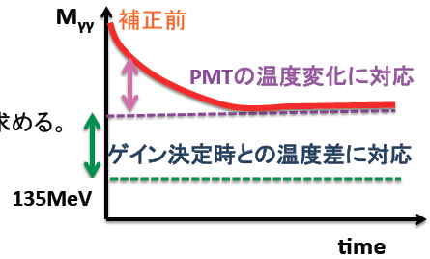
Method: 2-step correction
Fixed to the catalog value
(-0.3%/K)

Slide 17
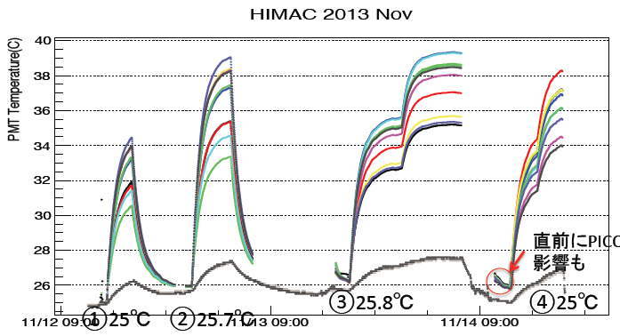
ΔT measurement for most PMTs
(HIMAC: To use multi-ch HV supply. Not a beam test.)
PMT holders modified for T sensors attached to all PMTs
<τ> = 57min; no PMT dependence

Slide 18
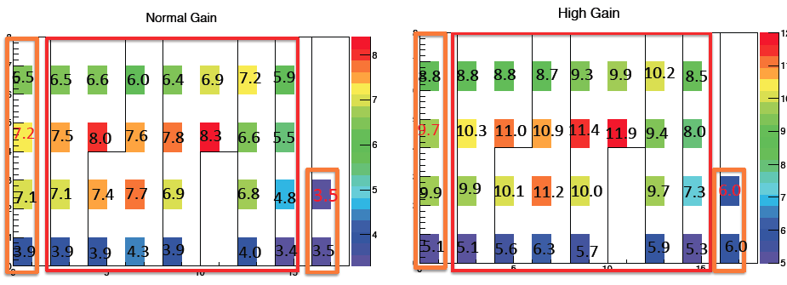
ΔT results

Slide 19
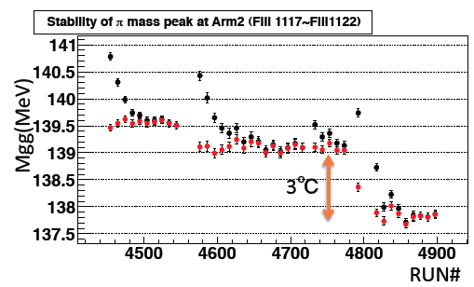
Short time scale correction

Slide 20
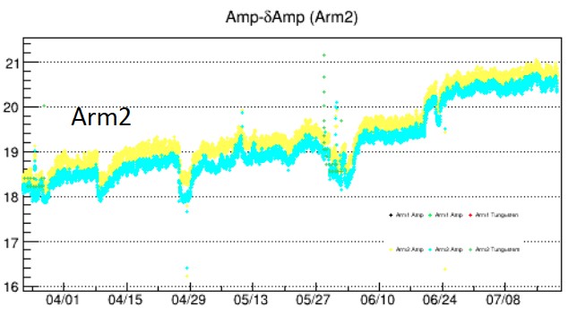
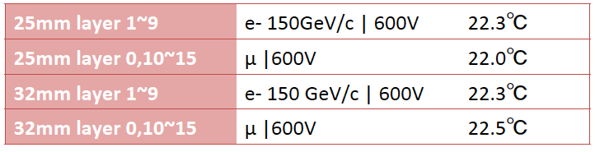
Environment Temperature
T _{LHC, env}
T_{amp} on the TAN
Power of amp was always ON
Shifted to T_{calorimeter} when everything switched off
T _{SPS,env}
T at the electonics rack
Analysis period in this study

Slide 21
Summary plot (w.r.t. #RUN)

Slide 22
Summary plot (w.r.t. Date)

Slide 23
What is Residual?

Slide 24
Homeworks
What is the effects of Hybrid, SciFi FEC?
T coefficients for all PMTs (now catalog value -0.3%/K)
Same measurements (ΔT) and analysis for Arm1
What is the difference between Arm1 and Arm2?
Radiation damage
After radiation damage
Some works in Firenze needed when we construct the detectors. Do you have a chiller?

