Slide 1
WELCOME
INTRODUCTORY
REMARKS
LCHF –WORKSHOP , July 06-2011
BY
A.PAGANO
ON BEHALF
INFN SEZIONE DI CATANIA

Slide 2
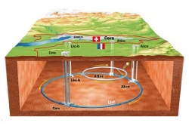
REMIND:
Scientists of INFN Catania are cooperating at LHC in the field of nuclear as well sub-nuclear physics . In sub-nuclear activity we have two experiments : CMS and LHCf. The CMS experiment’s purpose is to observe the products of proton-proton collisions . The main goals are the discovery of the Higgs boson and super symmetry.
The LHCf experiment attempts to observe those products of proton-proton collisions that are similar to the ones observed by interaction of cosmic rays with the Earth's atmosphere, in order to understand the mechanisms of the interaction and production of cosmic rays.
Adapted by (translation from italian by A.P.) : web-pag: INFN sezione di Catania, Alessia Tricomi (coordinator of gruppo 1 (Sub-nuclear)

Slide 3
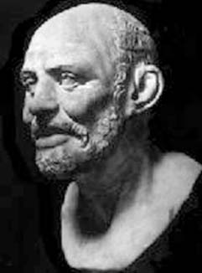
THE EARLY History OF LHC starts eventually
‘’…Democritus believes that the matter of what is indestructible consists of small substances (entities or atoms or solids), infinite in number;
He assumed that these are contained in another space, infinite in size; He called this space as a vacuum ....
He believes the atoms so small as to escape our experience……. The bodies move in space and eternally, because of their inequality meet and bind each other into a link that forces them to come into contact and so, remaining contiguous,
this bound state , however, does not produce a unique nature.
The fact that the bodies remain in contact with each other for some time, it was explained by the connections and the adhesion of the atoms: some of these, in fact are irregularly shaped, others hooked, some of them are concave, others convex, other different countless other ways ... ..'‘
Adapted(A.P.) original paper , by Simplicio: de caelo, 294,33
The atomic model of DEMOCRITUS (-450 b.c.)

Slide 4
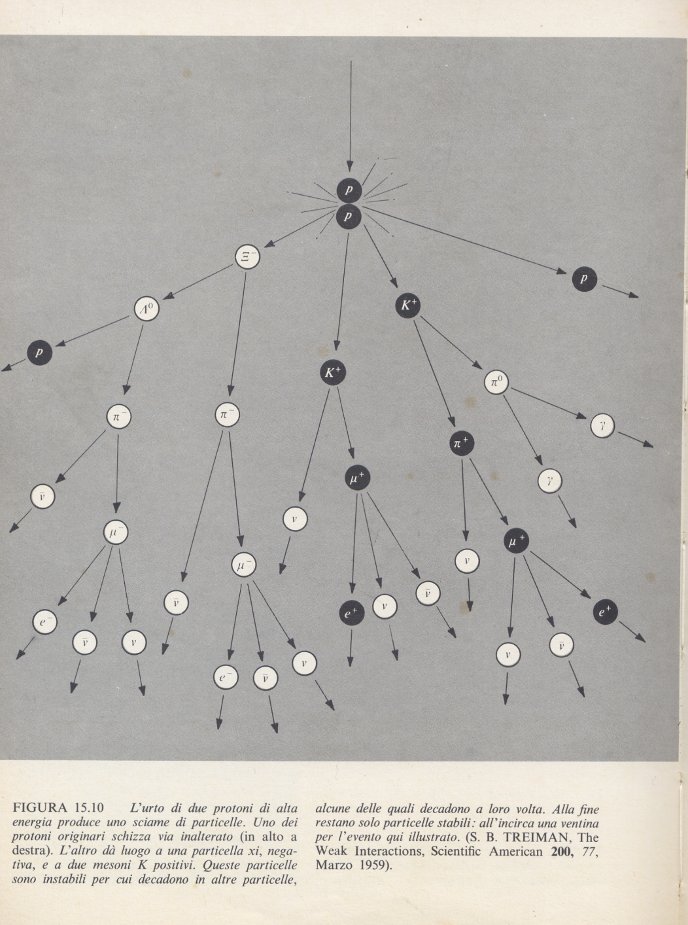
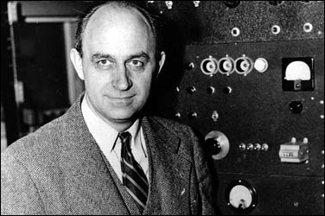
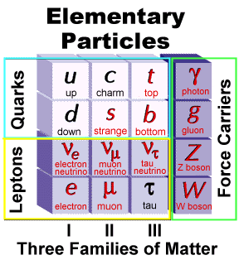
THE NEW ERA 2000 a.c. : the discovery of sub-nuclear particles
Mn
Mp

Slide 5
It is real pleasure for me to take part to this workshop,
on behalf of our INFN institution , welcome in Catania!
I hope you will enjoy the place, the city and the people.
I would like to thank you all for the enthusiastic adhesion to the workshop.
My personal thanks are due to the he organizers for the invitation to celebrate this meeting in Catania.
For us all, the event is a great opportunity, as well an important achievement of human and scientific cooperation.
06-07-2011
A.P.

