Slide 1
LHCf: status and future programs
Oscar Adriani
University of Florence & INFN Firenze
With introduction and summary for ‘young newcomers’

Slide 2
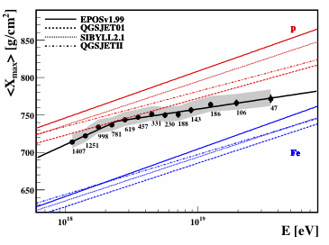
Hadronic models tuning after the first LHC data (for VHECR)
X_{max} as function of E and particle type
Pre LHC
Post LHC
PROTON
Auger Coll. ICRC2011
IRON
10¹⁸
10¹⁹
T.Pierog,
Cosmic QCD 2013 conference in Paris

Slide 3
Hadronic models tuning after the first LHC data (for VHECR)
X_{max} as function of E and particle type
Pre LHC
Post LHC
PROTON
Auger Coll. ICRC2011
LHC is really useful!!!!!!!
IRON
10¹⁸
10¹⁹
T.Pierog,
Cosmic QCD 2013 conference in Paris

Slide 4
LHCf Physics Program
Year | Beams | Beam energy | Proton equivalent energy in the LAB (eV) | Setup
2009 | p - p | 450+450 GeV | 4.3 10¹⁴ | Arm1+Arm2
2009/2010 | p - p | 3.5+3.5 TeV | 2.6 10¹⁶ | Arm1+Arm2
2013 | p – Pb | 4 TeV proton | 1.3 10¹⁶ | Arm2
2013 | p - p | 1.38+1.38 TeV | 4.1 10¹⁶ | Arm2
2015 | p - p | 6.5+6.5 TeV | 9 10¹⁶ | Arm1+Arm2 upgraded
? | p – light ions | ? | ? | ?
+ RHICf Activities, see Friday’s discussion

Slide 5
Inclusive photon spectrum analysis at 7 TeV and 900 GeV
A short review of already published results
“Measurement of zero degree single photon energy spectra for √s = 7 TeV proton-proton collisions at LHC“
PLB 703 (2011) 128
“Measurement of zero degree single photon energy spectra for √s = 900 GeV proton-proton collisions at LHC“
PLB 715 (2012) 298
Forward π⁰ spectra at 7 TeV
“Measurement of forward neutral pion transverse momentum spectra for √s = 7TeV proton-proton collisions at LHC“
PRD 86 (2012) 092001

Slide 6
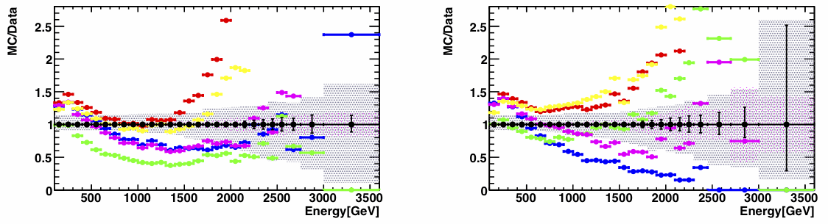
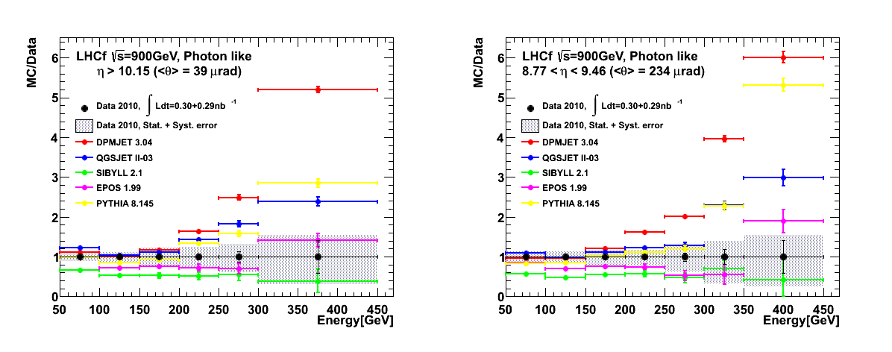
DATA vs MC : comp. 900GeV/7TeV
None of the model nicely agrees with the LHCF data
Here we plot the ratio MC/Data for the various models
> Factor 2 difference
η>10.94
8.81<η<8.9
7TeV
900GeV

Slide 7
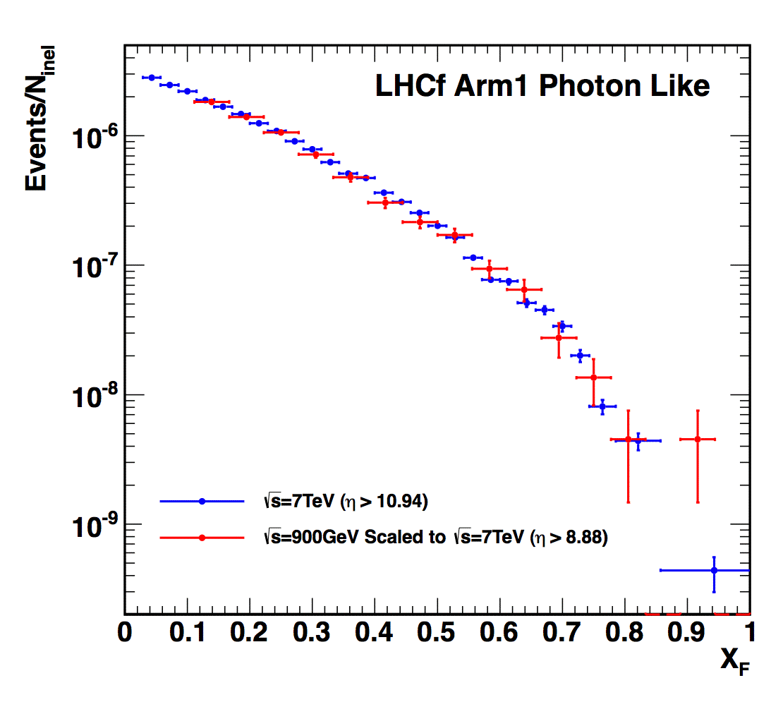
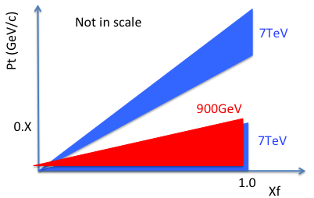

DATA : 900GeV vs 7TeV
Coverage of 900GeV and 7TeV
results in Feynman-X and P_{T}
XF spectra : 900GeV data vs. 7TeV data
900GeV vs. 7TeV
with the same PT region
Preliminary
small-η
Data 2010 at √s=900GeV
(Normalized by the number
of entries in X_{F} > 0.1)
Data 2010 at √s=7TeV (η>10.94)
Normalized by the number of entries in X_{F} > 0.1
No systematic error is considered in both collision energies.
Good agreement of X_{F} spectrum shape between 900 GeV and 7 TeV.
➔weak dependence of <pT> on ECMS

Slide 8
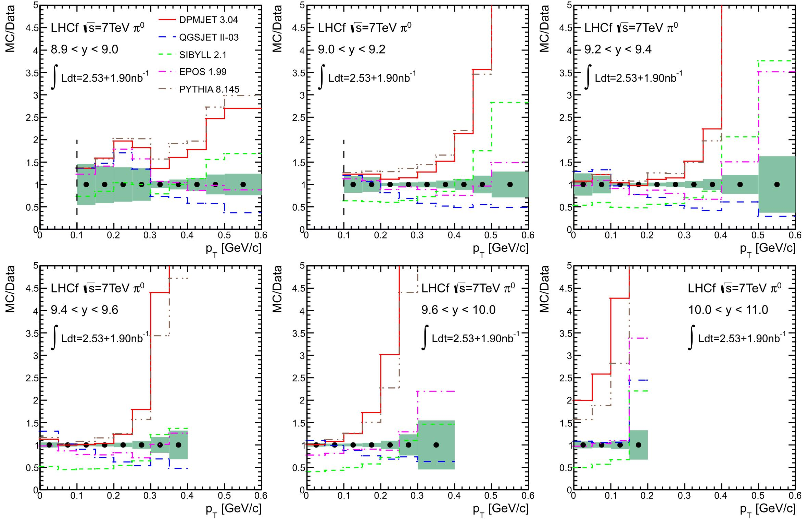
π⁰ P_{T} spectra for various y bin: MC/data
DPMJET 3.04 QGSJETII-03 SIBYLL 2.1 EPOS 1.99 PYTHIA 8.145
EPOS gives the best agreement both for shape and yield.
MC/Data
0
P_{T}[GeV]
0.6
0
P_{T}[GeV]
0.6
0
P_{T}[GeV]
0.6
MC/Data
0
P_{T}[GeV]
0.6
0
P_{T}[GeV]
0.6
0
P_{T}[GeV]
0.6

Slide 9
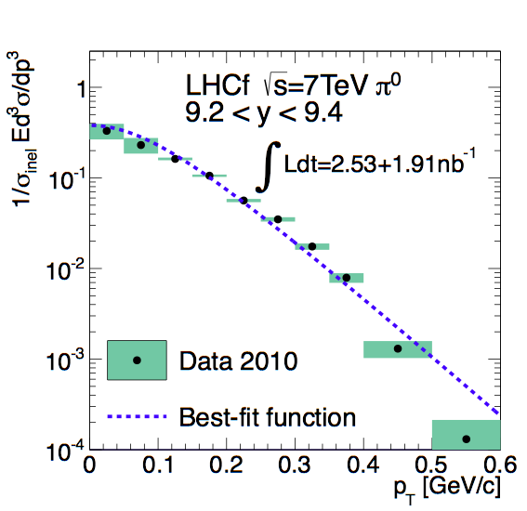
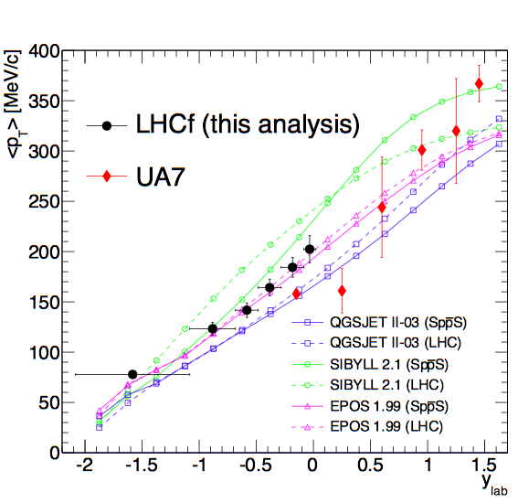


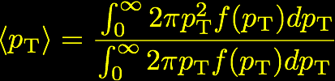
π⁰ analysis at √s=7TeV
Submitted to PRD (arXiv:1205.4578).
pT spectra vs best-fit function
Average pT vs ylab
PLB 242 531 (1990)
Y_{Beam}=6.5 for SPS
Y_{Beam}=8.92 for7 TeV LHC
ylab = ybeam - y
1. Thermodynamics
(Hagedron, Riv. Nuovo Cim. 6:10, 1 (1983))
Systematic uncertainty of LHCf data is 5%.
Compared with the UA7 data (√s=630GeV) and MC simulations (QGSJET, SIBYLL, EPOS).
Two experimental data mostly appear to lie along a common curve
→ no evident dependence of <pT> on ECMS.
Smallest dependence on ECMS is found in EPOS and it is consistent with LHCf and UA7.
Large ECMS dependence is found in SIBYLL
2. Numerical integration
actually up to the upper bound of histogram

Slide 10
On going analysis
Neutrons at 7 TeV pp collisions
The 2013 p-Pb run

Slide 11
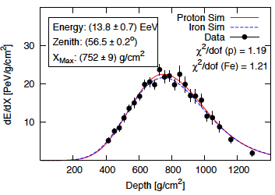
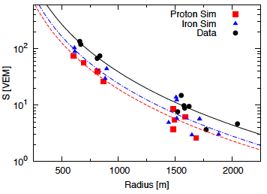
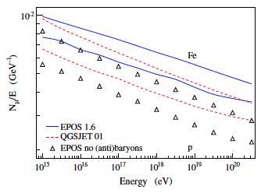
Muon excess at Pierre Auger Obs.
Pierre Auger Collaboration, ICRC 2011 (arXiv:1107.4804)
Auger hybrid analysis
event-by-event MC selection to fit FD data (top-left)
comparison with SD data vs MC (top-right)
muon excess in data even for Fe primary MC
EPOS predicts more muon due to larger baryon production
=> importance of baryon measurement
Pierog and Werner, PRL 101 (2008) 171101

Slide 12
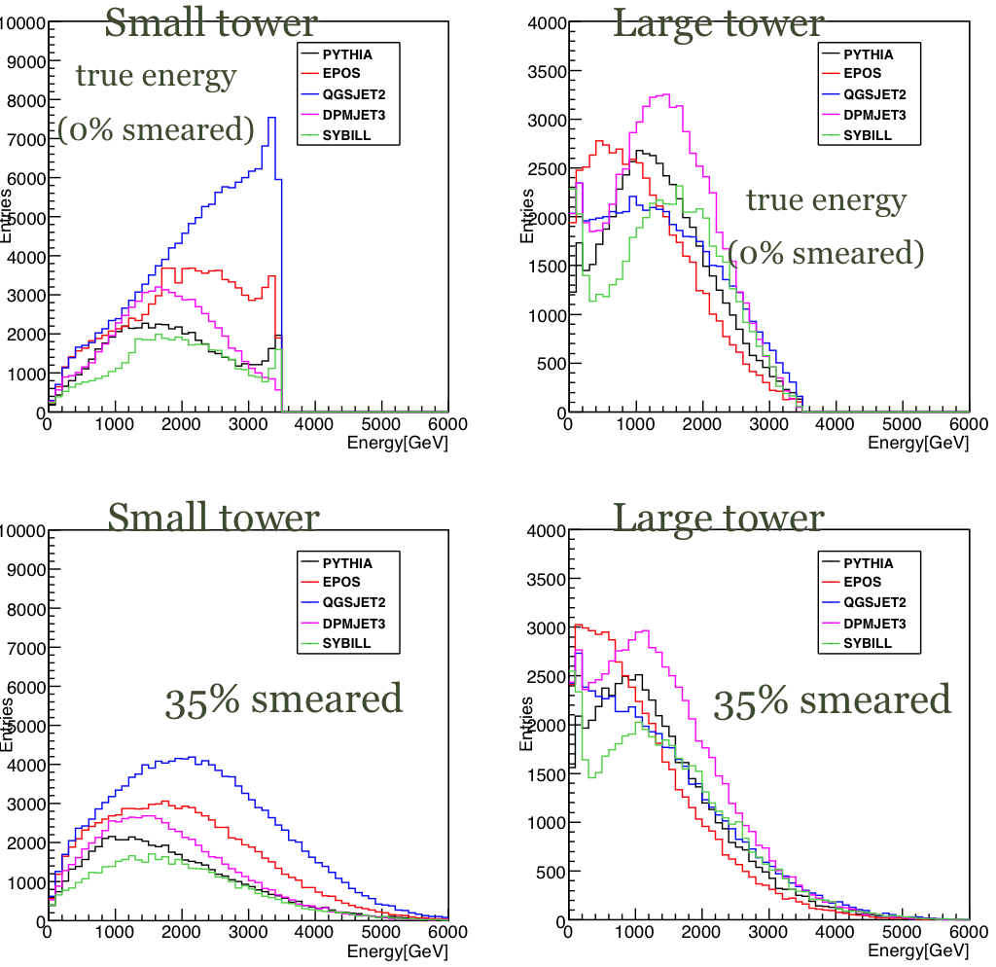
The challenge of n analysis
Very big discrepancies
between models →Useful measurement!
Performance
for neutrons
  35% E_{res}
  1mm Position Res.
  @ 1.5TeV n
  And….
  Detector performance
  is also interaction
  model dependent.
Unfolding is essential to extract physics results from the measured spectra
MC
Detector performance

Slide 13
See dedicated talk on neutrons in p-p collisions
Mitsuka/Massimo talk on n spectra
Kawade paper on neutron performances

Slide 14
And γ P_{T} vs η spectra at 7 TeV….
For the moment nobody is really working on it!!!!…..

Slide 15



The 2013 p-Pb run at √s_{NN} = 5 TeV
2013 Jan-Feb for p-Pb/Pb-p collisions
  Installation of the only Arm2 at one side (silicon tracker good for multiplicity)
  Data both at p-side (20Jan-1Feb) and Pb-side (1fill, 4Feb), thanks to the swap of the beams
Details of beams and DAQ
  L = 1x10²⁹ – 0.5x10²⁹cm⁻²s⁻¹
  ~200.10⁶ events
  β* = 0.8 m, 290 μrad crossig angle
  338p+338Pb bunches (min.ΔT = 200 ns), 296 colliding at IP1
  10-20 kHz trig rate downscaled to approximately 700 Hz
  20-40 Hz ATLAS common trig. Coincidence successful!
  p-p collisions at 2.76 TeV have also been taken
3.5cm,
4.0cm
p
IP1
IP2
Arm2
IP8
Pb

Slide 16
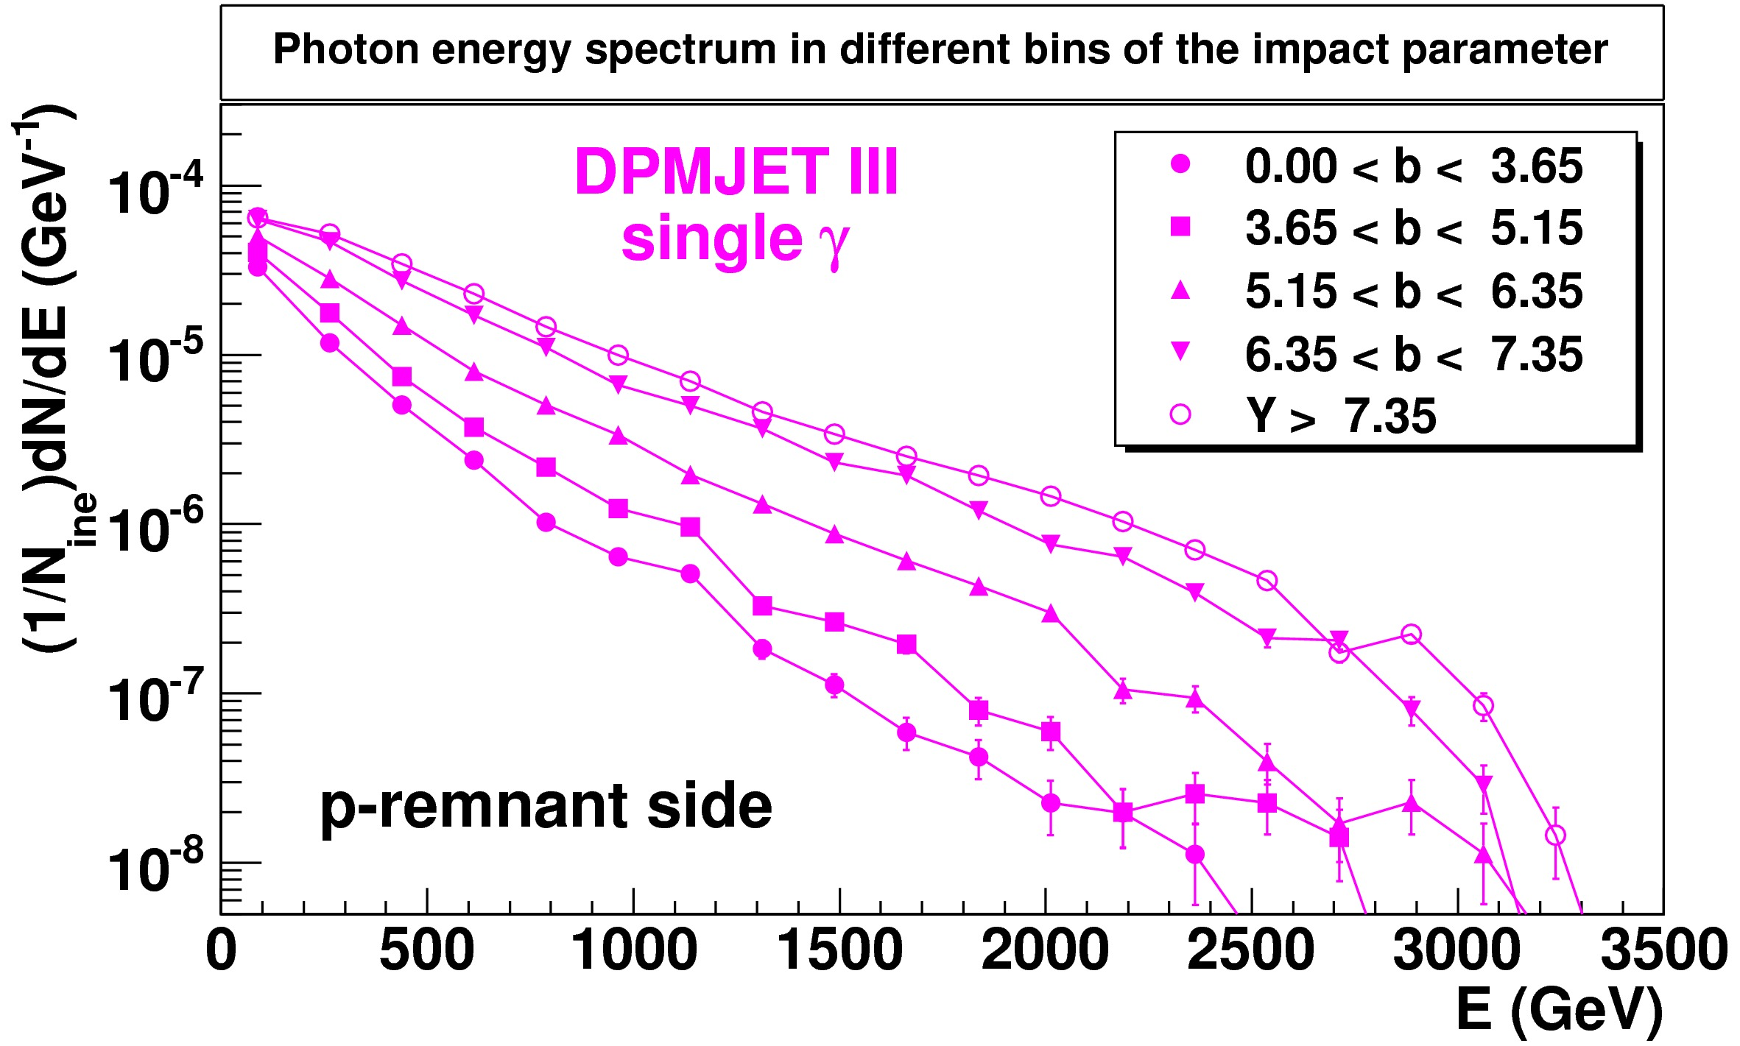
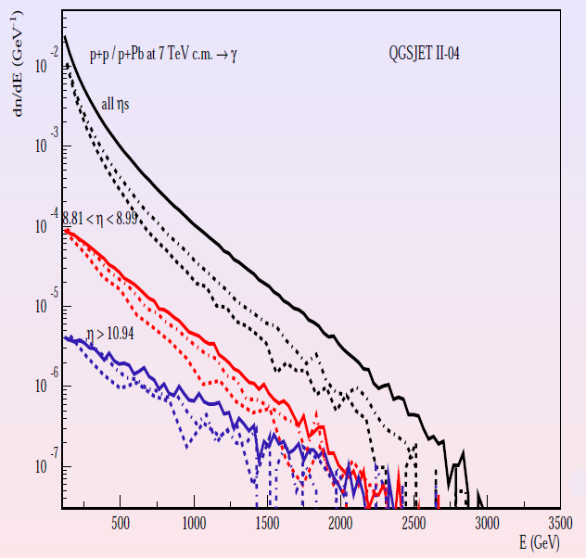
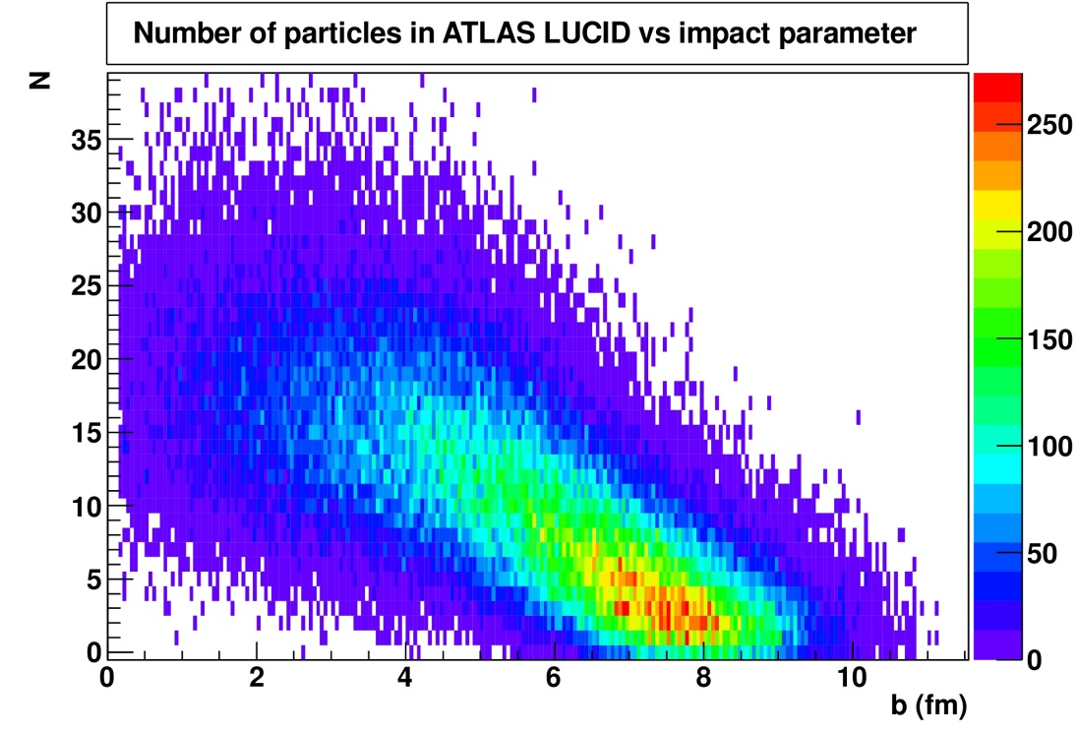
Physics in pA
QGSJET II-04
All η
8.81<η<8.99
η>10.94
p-p
p-N
p-Pb
Nuclear effect in the forward particle production
Photon spectra for different impact parameters
(Courtesy of S.Ostapchenko)
Please observe that the impact parameter can be obtained from Atlas Lucid, for ex.!
Frankly speaking……
No big feedback from ATLAS….
Photon spectra at different η in p-p, p-N and p-Pb collisions
Is p-Pb good test for p-atmosphere?

Slide 17
p-Pb analysis ongoing
π⁰ spectra (Mitsuka’s talk)
γ spectra (Lorenzo’s talk)
n impact point (Lorenzo’s talk) (and spectra in the future)
Ultra Peripheral Collisions (Menjo’s talk)

Slide 18
The status of the upgrades
Arm1 and Arm2 are currently dismounted in Florence
Calorimeter radiation hardening by replacing plastic scintillator with GSO is in progress
Production and laboratory tests of the new scintillators in Japan is finished both for Arm1 and Arm2
Multiple Beam tests at Ion facility (HIMAC) have been done
  See Menjo’s talk
Upgrade of the silicon positioning measurement system under way
    See Lorenzo/Raffaello’s talk
Test Beam at LNS for the absolute energy calibration of the silicon system has been assigned for 2014
  See Alessia’s talk
Summer 2014: assembly of Arm1 and Arm2 in Florence
Test beam at SPS in Autumn 2014
Re-installation in LHC at the end of 2014

Slide 19
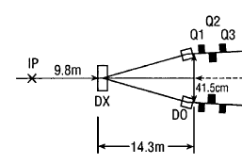
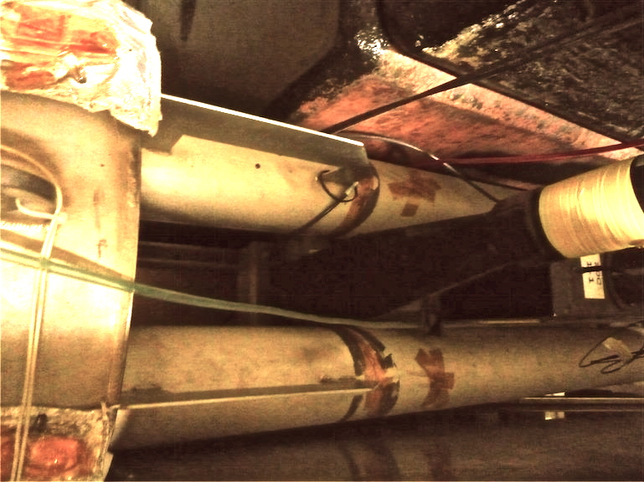
LHCf: future plan
p-p at 13TeV (2015)
Main target: measurement at the LHC design energy.
Study of energy scaling by comparison with √s = 900 GeV and 7 TeV data
p-light ions (O, N) at the LHC (2019?)
It allows studying HECR collisions with atmospheric nuclei.
RHICf experiment at RHIC
Lower collision energy, ion collisions.
See Sako’s talk
p-p collisions:
Max. √s = 500 GeV
Polarized beams
Ion collisions:
Au-Au, d-Au
Max. √s = 200 GeV
Possible, d-O,N (p-O,N)
➔ Cosmic ray – Air
@ knee energy.
10cm
detector

Slide 20
And some additional analysis topics
Additional meson and baryion production analysis
  η, K⁰_{s} (with the decays in 2/4 γ)
    Mitsuka and Menjo have done some work, but not finalized
Joint analysis with Atlas of p-Pb (and 13 TeV p-p)
  Forward production correlated with centrality
    Lorenzo is trying to have feedback from Atlas, not easy…..

Slide 21
Common trigger with ATLAS
MC
impact parameter vs. # of particles in ATLAS LUCID
LHCf forced to trigger ATLAS
Impact parameter may be determined by ATLAS
Identification of forward-only events

Slide 22
2014-2015 work in summary
Analysis: everytime, everywhere…
New silicon modules assembly
LNS test beam for silicon calibration
Arm1 and Arm2 assembly in Florence
SPS Test beams
LHC re-installation
LHC 13 TeV Run
LHC dismounting
RHICf activities?????
2014 | Jan-March
 | April-June
 | June-August
 | October
 | December?
2015 | Jan-March
 | April
 | ……

Slide 23
Let’s start the real meeting now!!!!

Slide 24
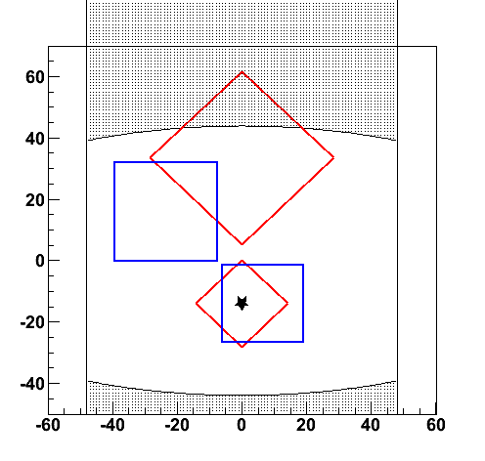
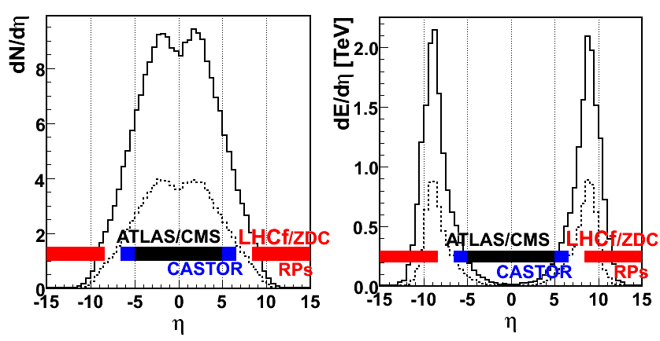
What LHCf can measure
Front view of calorimeters
@ 100μrad crossing angle
η
Energy spectra and
Transverse momentum distribution of
beam pipe shadow
8.5
Gamma-rays (E>100GeV,dE/E<5%)
Neutral Hadrons (E>a few 100 GeV, dE/E~30%)
π⁰ (E>600GeV, dE/E<3%)
at pseudo-rapidity range >8.4
∞
Multiplicity@14TeV
Energy Flux @14TeV
Low multiplicity !!
High energy flux !!
simulated by DPMJET3
Notes:
Next, I present what we can measure.
We can measure energy spectra and transverse momentum distribution of gamma-ray with more than 100GeV
and neutral hadrons it’s mainly neutrons with more than a few hundreds GeV, and neutral pions with more than 700GeV
at rapidity range from 8.4 to infinity.
because we don’t have own central detectors and LHCf trigger is completely independent on ATLAS trigger,
so LHCf can measure only inclusive spectra . However we are recording ATLAS event ID number event by event,
so it is possible to identify coincidence events with ATLAS event and to analyze with ATALS in future.

